Slide 1

Lecture 11 The Sparse Extended Information Filter
Department of Mechanical Engineering and Automation
Haoyao Chen

Slide 2
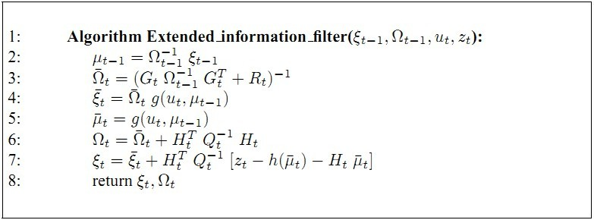
Simultaneous Localization and Mapping
A robot acquires a map while localizing itself relative to this map.
Online SLAM problem Full SLAM problem
Estimate map m and current position x_{t} Estimate map m and driven path x_{1:t}

Slide 3
SEIF SLAM
SEIF SLAM reduces the state vector y again to the current position x_{t}
This is the same state vector y as EKF SLAM

Slide 4
State estimate
SEIF SLAM requires every timestep inference to estimate the state
The state estimation is also done by GraphSLAM, as a post-processing step.

Slide 5
Sparseness of Information Matrix
After a while, all landmarks are correlated in EKF’s correlation matrix
The normalized information matrix is naturally sparse; most elements are close to zero (but none is zero).

Slide 6
Information matrix
Covariance
Highly correlative
Sparse

Slide 7
Acquisition of the information matrix

Slide 8
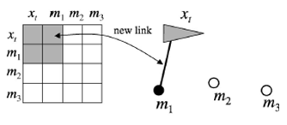
Acquisition of the information matrix
The observation of a landmark m₁ introduces a constraint:
The constraint is of the type:
The information vector increases with the term:
Where h(x_{t},m_{j}) is the measurement model and Q_{t} the covariance of the measurement noise.

Slide 9
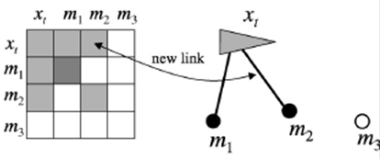
Acquisition of the information matrix
The observation of a landmark m₂ introduces another constraint:

Slide 10
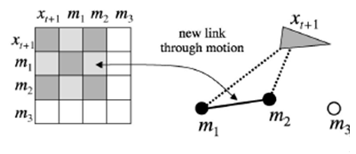
Acquisition of the information matrix
The movement of the robot from x₁ to x₂ also introduces an constraint:
The constraint is now between the landmarks m₁ and m₂ (and not between the path x_{t-1} to x_{t}):

Slide 11
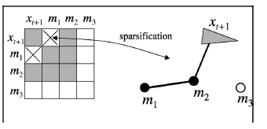
Acquisition of the information matrix
The information matrix can become really sparse by applying a sparsification step:
This is done by partition the set of features into three disjoint subsets:
Where m⁻ is the set of passive features and m⁺ ∩ m⁰ is the set of active features. The number of features that are allowed to remain active (set m⁺) is thresholded to guarantee efficiency.

Slide 12
Network of features
Approximate the sparse information matrix with the argument that not all features are strongly connected:

Slide 13
Updating the current state estimate
The current state estimate is needed every timestep:
Yet, from the current state estimate only subset is needed:
i.e. the robot position x_{t} and the locations of the active landmarks m^{+.}
This can be done with an iterative hill climbing algorithm:
Where F_{i} is a projection matrix to extract element i from matrix Ω.

Slide 14
Algorithm
The algorithm combines the four steps; two updates and two approximations:
approximation
approximation

Slide 15
Motion Update

Slide 16
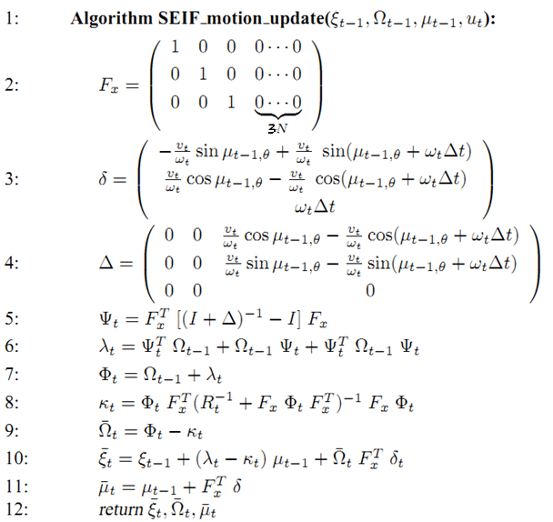
Motion Update

Slide 17
Mathematical Derivation of Motion Update
Velocity model
where

Slide 18
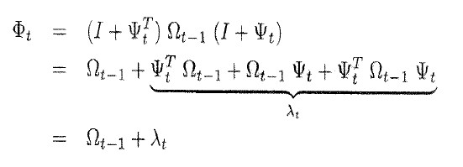
Mathematical Derivation of Motion Update
Inverse Lemma, Page 50
How to calculate?

Slide 19
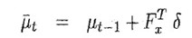
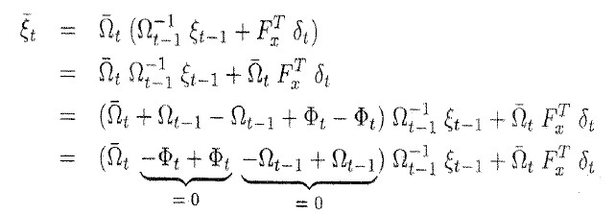
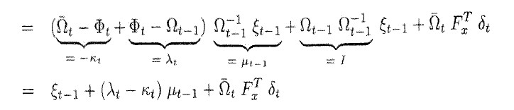
Mathematical Derivation of Motion Update

Slide 20
Measurement Update

Slide 21
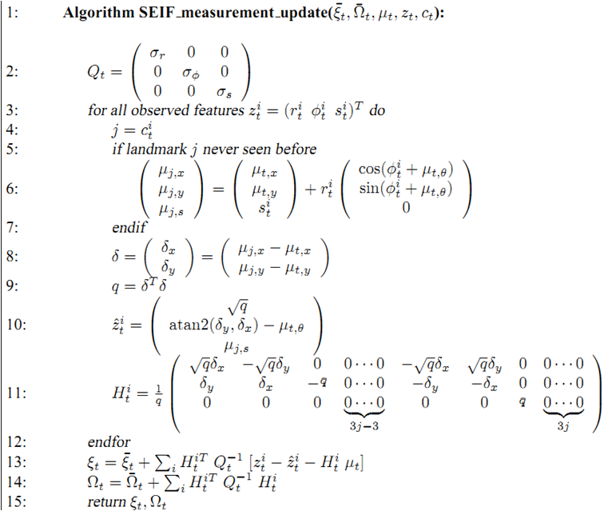
Measurement Updates

Slide 22
Mathematical Derivation of Mea Update
Multiple Measurements:

Slide 23
Sparsification (Key Step!!!!!!!!!!!!)

Slide 24
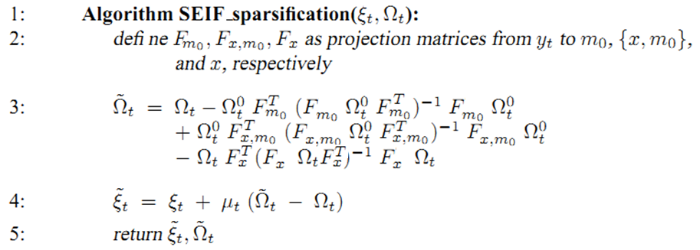
Sparsification (Key Step!!!!!!!!!!!!)

Slide 25
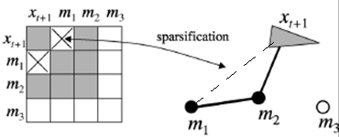
Mathematical Derivation of Sparsification
Basic Idea:
cut the direct link
between a and b

Slide 26
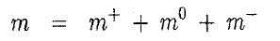
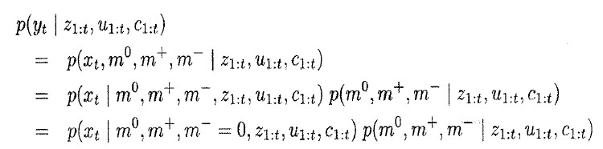
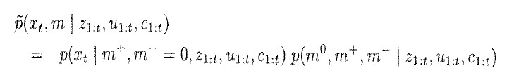
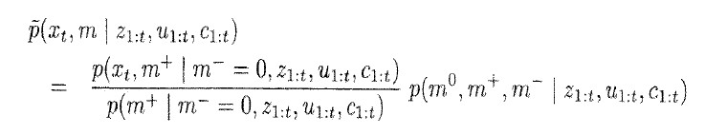
Mathematical Derivation of Sparsification
Assumption: Weak link between passive features
and Robot current Pose
cut the direct link m⁰

Slide 27
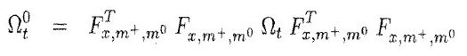
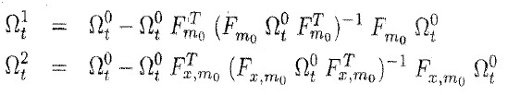
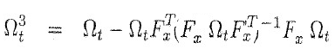
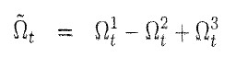
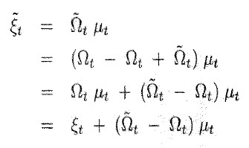
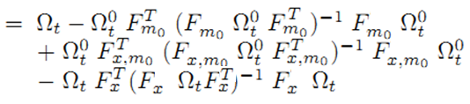
Mathematical Derivation of Sparsification

Slide 28
State Recovery or Update State Estimate

Slide 29
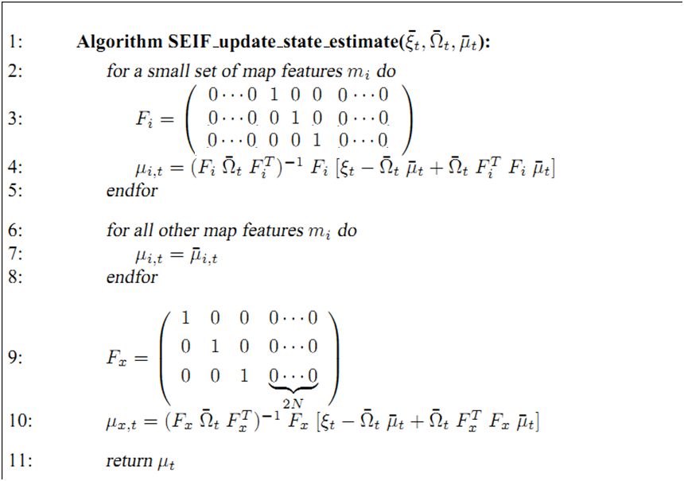
State Recovery

Slide 30
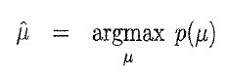
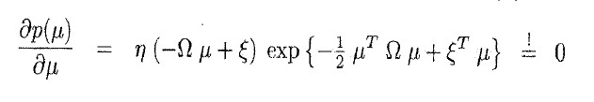
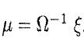
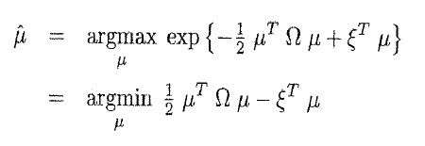
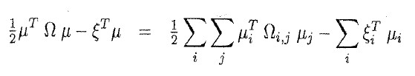
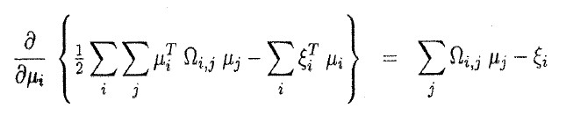
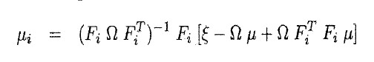
Mathematical Derivation of Sparsification
Other method?
Coordinate Descent

Slide 31
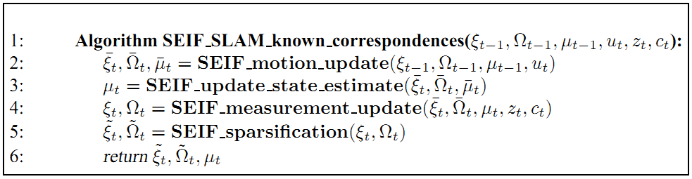
SEIF SLAM with known correspondences

Slide 32
The effect of sparsification
The computation requires ‘constant’ time:

Slide 33
The effect of sparsification
The memory scales linearly:

Slide 34
The effect of sparsification
The prize is less accuracy, due to the approximation:

Slide 35
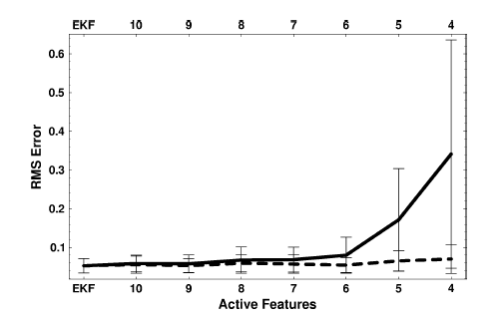
The degree of sparseness
By choosing the number of active features, accuracy can be traded against efficiency :

Slide 36
Effect of approximation
The effect of sparsification is less links between landmarks, more confidence, but nearly same information matrix:

Slide 37
Multi-Robot SLAM
Compared to Single SLAM
Relative pose of two robots is unknown. Correspondence problem becomes global;
Merging maps: alignment;
The degree of overlap between different maps unknown.

Slide 38
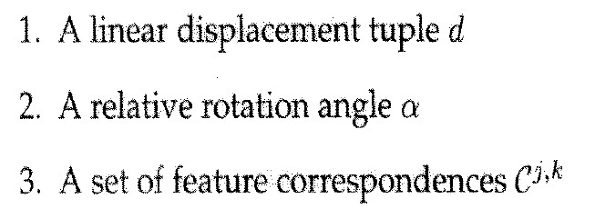
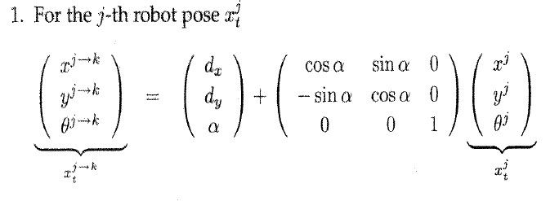
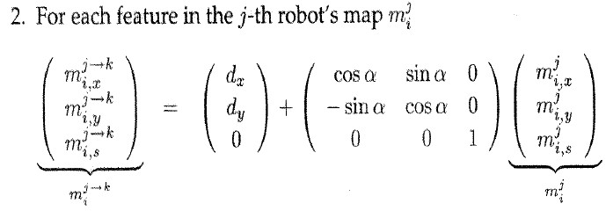
Multi-Robot SLAM - Integrating Maps(2D)
known relative pose and Correspondences

Slide 39
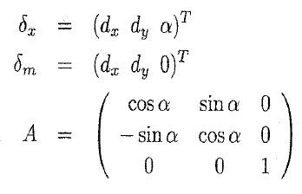
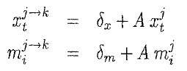
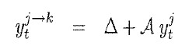
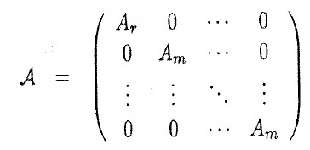
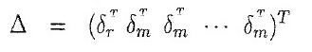
Multi-Robot SLAM - Integrating Maps(2D)
Stack all
where

Slide 40
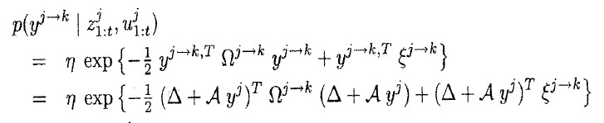
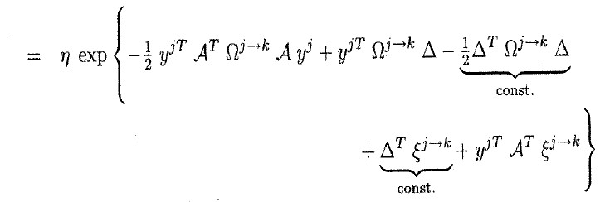
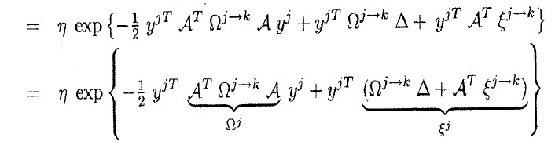
Multi-Robot SLAM - Integrating Maps(2D)

Slide 41
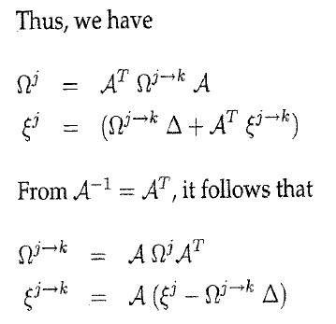
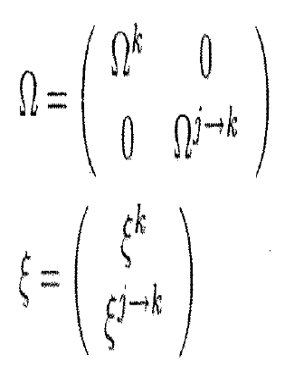
Multi-Robot SLAM - Integrating Maps(2D)

Slide 42
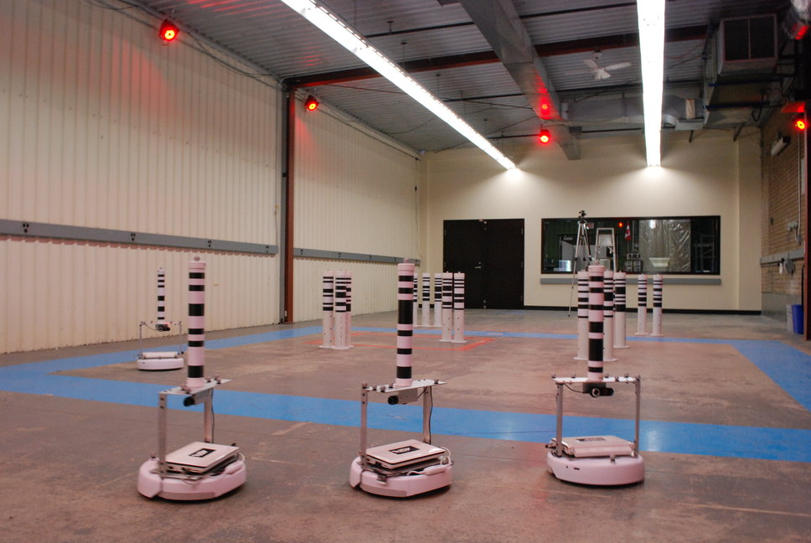
Multi-Robot SLAM - Calculate Relative Pose
Strategy 1: Matching features’ relative pose constraints –not robust
Strategy 2: Unary Constraints: Color, SIFT, SURF, Brief….. –Robust
Strategy 3: Localization-based –Robust [*]
Strategy 4: Direct observation
*B. X. Zhang, J. Liu, and H. Chen, “AMCL based map fusion for multi-robot SLAM with heterogenous sensors,” ICIA, 2013

Slide 43
Multi-Robot SLAM - Fusing the identical features in the total map
Method: Directly collapse the corresponding rows and columns of the the identical features

Slide 44
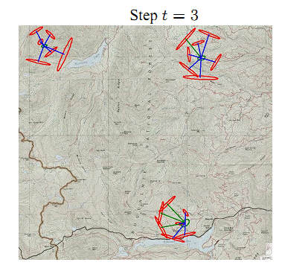
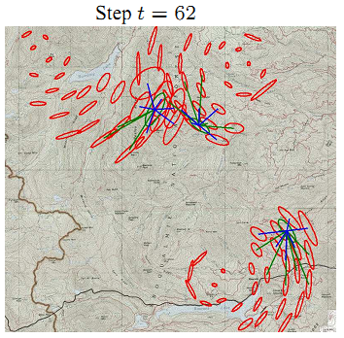
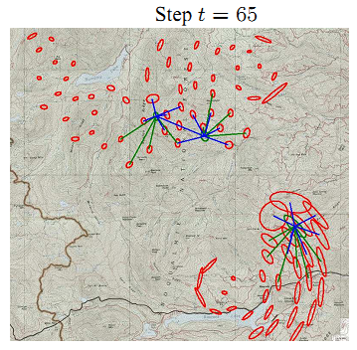



Multi-Robot SLAM

Slide 45
Reference for Multi-robot SLAM
S. Thrun, and Y. Liu. Multirobot SLAM with sparse extended information filters. In Proceedings of the 11th International Symposium of Robotics Research (ISRR’03), Italy, 2003.
A. Howard, G. S. Sukhatme, M. J. Mataric. Multi-robot mapping using manifold representations. In Proceedings of IEEE International Conference on Robotics and Automation, 2004.
Howard. Multi-robot simultaneous localization and mapping using particle filters. International Journal of Robotics Research, vol. 25, no.12, pp. 1243-1256, 2006.
B. Kim, M. Kaess, L. Fletcher, J.J. Leonard, A. Bachrach, N. Roy, S. Teller. Multiple relative pose graphs for robust cooperative mapping. IEEE Intl. Conf. on Robotics and Automation, May 3-8, pp. 3185-3192, Anchorage, 2010.
C. Gong, S. Tully, G. Kantor, H. Choset. Multi-agent deterministic graph mapping via robot rendezvous. IEEE Conf. on Robotics and Automation, May 14-18, pp. 1278-1283, Minnesota, 2012.
H.J. Chang, C.S.G. Lee, Y.C. Hu, Y.H. Lu. Multi-robot SLAM with Topological/Metric maps, IEEE/RSJ Conf. on Intelligent Robots and Systems, Oct. 29-Nov. 2, pp. 1467-1472, San Diego, 2007.
Leung, K. Y. K., Barfoot, T. D., and Liu, H. H. T. “Decentralized Localization of Sparsely-Communicating Robot Networks: A Centralized-Equivalent Approach.” IEEE Transactions on Robotics, 26(1):62–77, 2010.

Slide 46
Summary
SEIF contains four steps: Motion update; State Estimation; Measurement Update; Sparsification.
Sparsification is the Key.
SEIF performs better than EKF in computation and Memory Requirements, but worse in the accuracy.
SEIF can be easily used for multi-robot SLAM

Slide 47
Homework
Introduce the Hash Table and KD-tree

